Slide 2
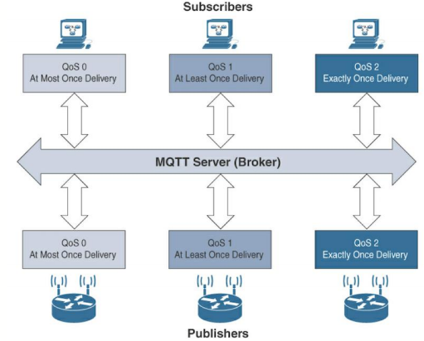
Imagine a factory where many manufacturing processes are taking place. Each process or machine might broadcast a success/failure signal, or a signal when an iteration of a process on a product is complete.
Advantages
Can set high or low reliability depending on needs via QoS levels
Less overhead than HTTP
Publish/Subscriber model is easily scalable for more machines being added
Each new machine can selectively choose what other machines it needs to know about, and each other machine can decide if they need to know about the new machine’s publications (many-to-many relationship)
Disadvantages
High power requirements (easily supplied in immobile factory)
Requires reliable broker (easy to maintain in a factory environment)
Relatively high processing requirements (versus CoAP)

Slide 3

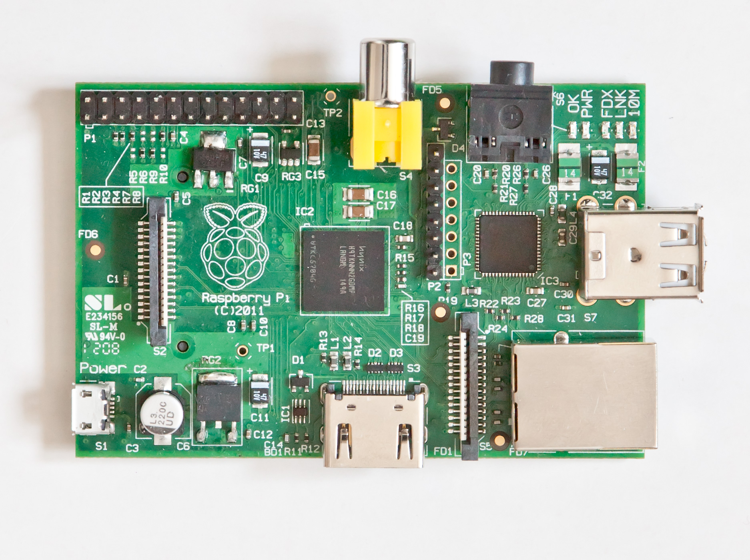
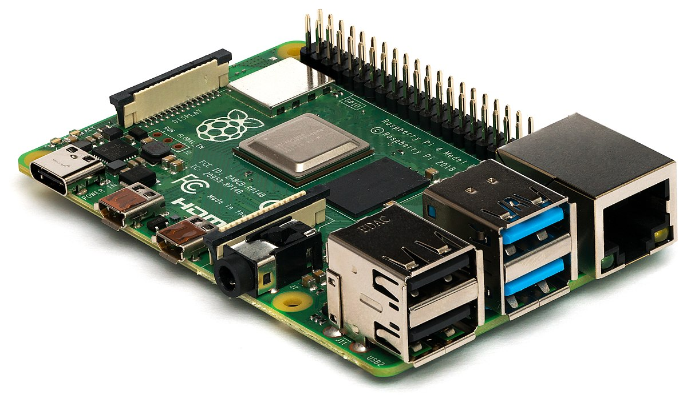
Heterogeneous Devices

Slide 4
I don’t give out any data, but care about red, yellow, and blue data.
I care about only red and yellow topics, but give out red, blue and yellow data.
I don’t care about receiving any data, but I give out red, blue and yellow data.

Slide 5
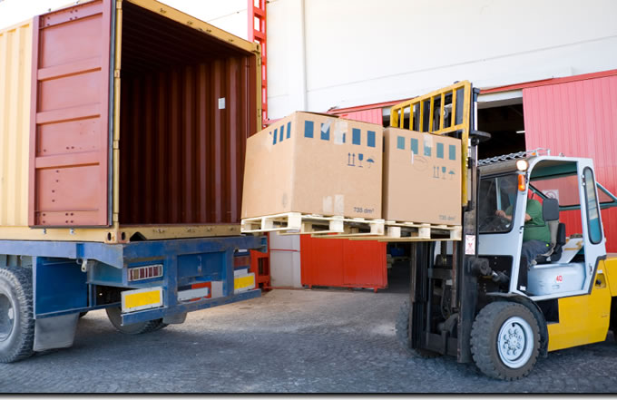
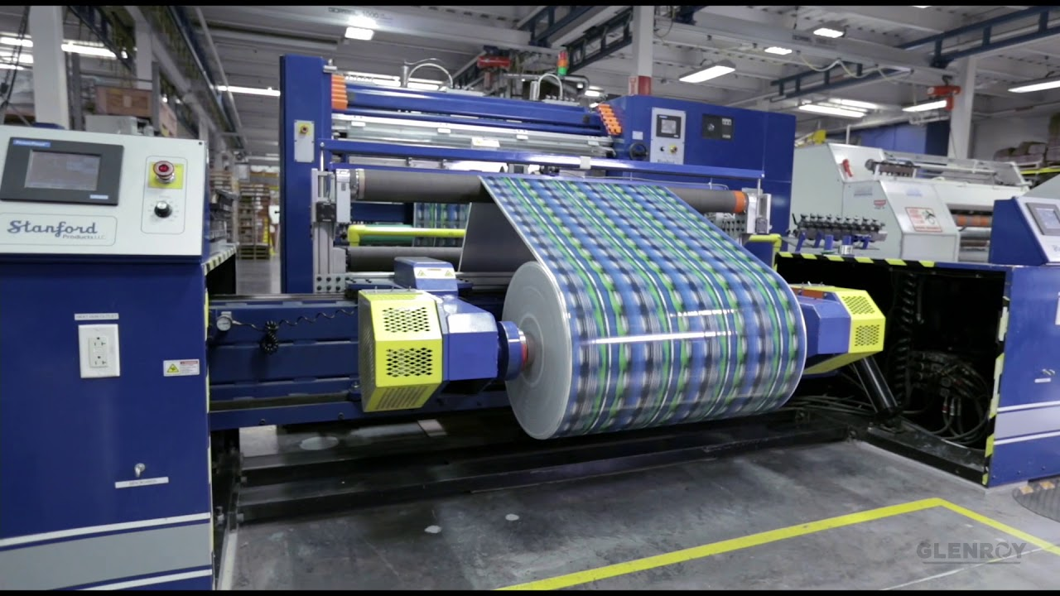
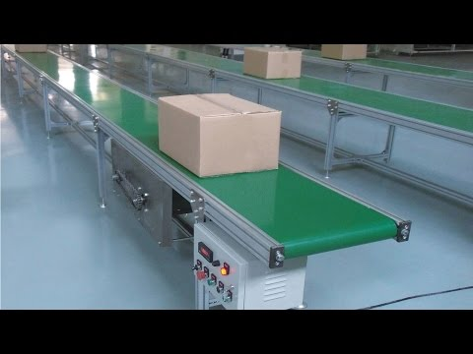
Broker
I don’t give out any data, but care about red, yellow, and blue data.
Example: finished product, or light display
I care about only red and yellow topics, but give out red, blue and yellow data.
Example: Central factory process
I don’t care about receiving any data, but I give out red, blue and yellow data.
Input example: shipment receipt

Slide 6
https://www.raspberrypi.org/forums/viewtopic.php?t=4751
https://www.currys.co.uk/gbuk/computing/laptops/laptops/hp-15-db0521sa-15-6-amd-a6-laptop-1-tb-hdd-grey-10180991-pdt.html
https://en.wikipedia.org/wiki/Raspberry_Pi

